Slide 2

Three.js
open source JavaScript API
for creating and displaying animated 3D computer graphics on a web browser.

Slide 3
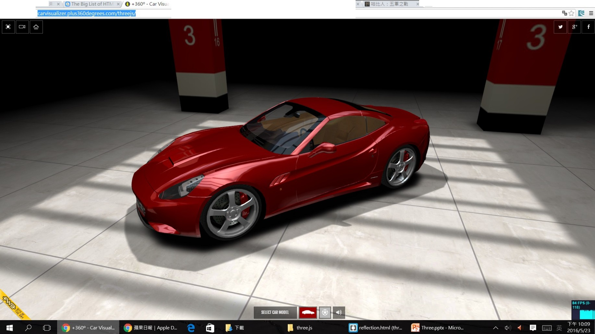

Slide 4



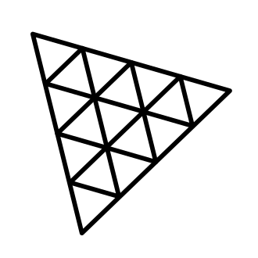
Three.js is a 3D library that tries to make it as easy as possible to get 3D content on a webpage.
WebGL generally requires quite a bit of code and that is where three.js comes in.

Slide 5
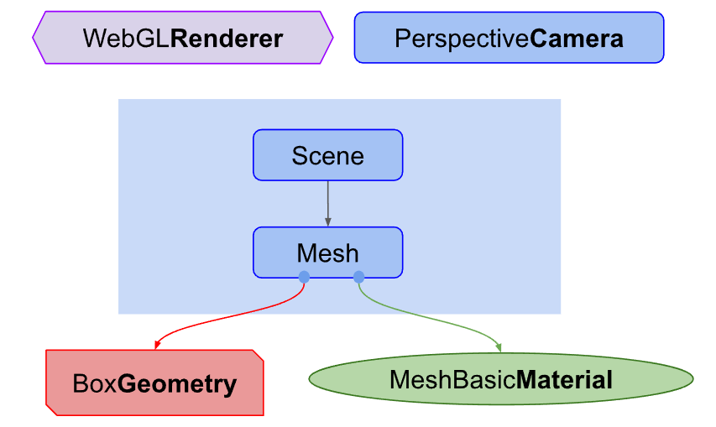
Hello Cube
Renderer
You pass a Scene and a Camera to a Renderer
It renders (draws) the portion of the 3D scene that is inside the frustum of the camera as a 2D image to a canvas

Slide 6
Hello Cube
Scene
Scene object defines the root of the scenegraph.
Mesh
Mesh objects represent drawing a specific Geometry with a specific Material.

Slide 7
Hello Cube
Geometry
Geometry objects represent the vertex data of some piece of geometry like a sphere, cube, plane, tree, building, etc...
Material
Material objects represent the surface properties used to draw geometry including things like the color to use and how shiny it is.

Slide 8

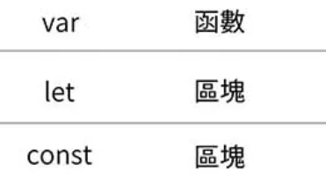
<!DOCTYPE html>
<html>
<head>
<title>My first three.js app</title>
<style>
body { margin: 0; }
</style>
</head>
<body>
<canvas id="c"></canvas>
<script type="module">
import * as THREE from "https://cdn.skypack.dev/three@0.132.2";
import { OrbitControls } from "https://cdn.skypack.dev/three@0.132.2/examples/jsm/controls/OrbitControls.js";
const renderer;
const scene;
const camera;
</script>
</body>
</html>
無邊界，body會佔滿整個視窗

Slide 9
skeleton
<script type="module">
import * as THREE from …;
</script>
type="module" enables us to use the import keyword to load three.js

Slide 10
skeleton
import * as THREE from "https://cdn.skypack.dev/three@0.132.2";
import everything from the three.js core under the THREE namespace
import { OrbitControls } from "https://cdn.skypack.dev/three@0.132.2/examples/jsm/controls/OrbitControls.js";
importing plugins (a camera controls plugin)

Slide 11

Hello cube - draw into that canvas
const canvas = document. getElementById('c');
const renderer = new THREE.WebGLRenderer({antialias: true, canvas});
...
WebGLRenderer：The renderer is the thing responsible for actually taking all the data you provide and rendering it to the canvas

Slide 12
Hello cube - create a camera
const fov = 75;
const aspect = 2; // the canvas default
const near = 0.1;
const far = 5;
const camera = new THREE.PerspectiveCamera(fov, aspect, near, far);
fov is short for field of view. In this case 75 degrees in the vertical dimension.
aspect is the display aspect of the canvas. By default a canvas is 300x150 pixels which makes the aspect 300/150 or 2.

Slide 13
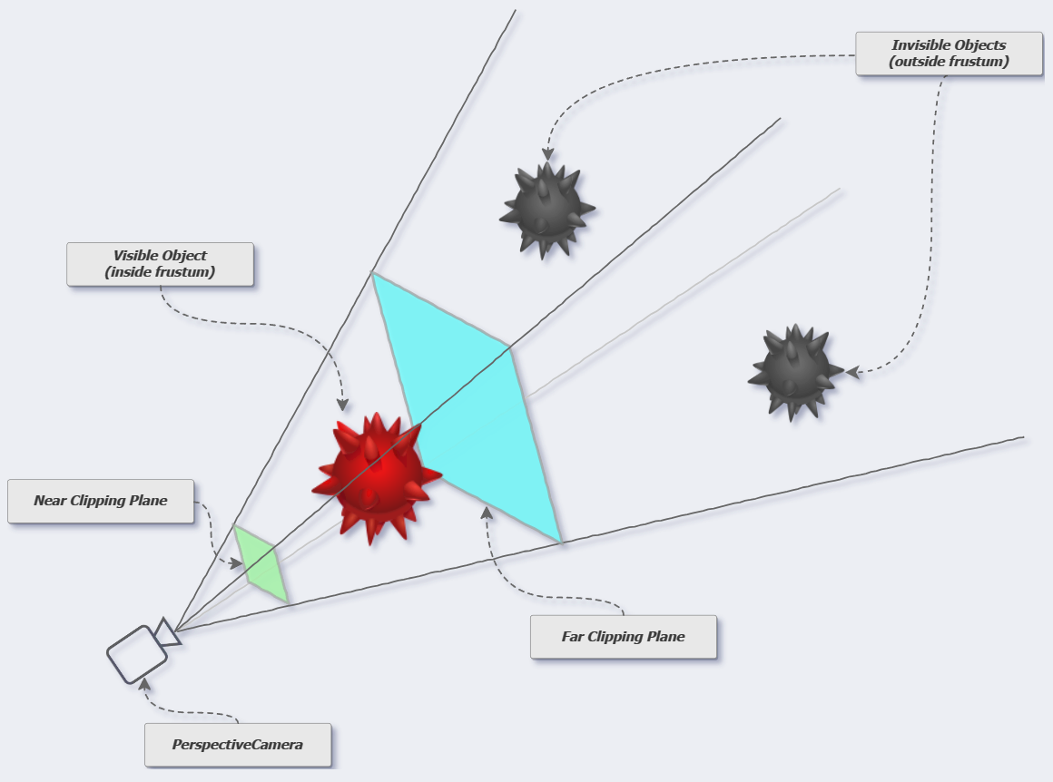
fov

Slide 14
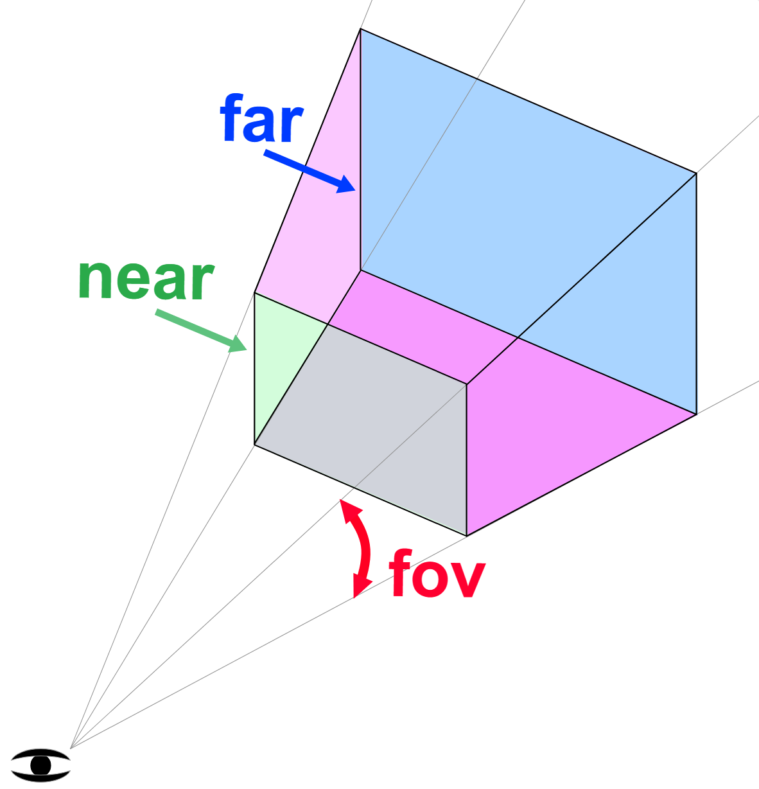
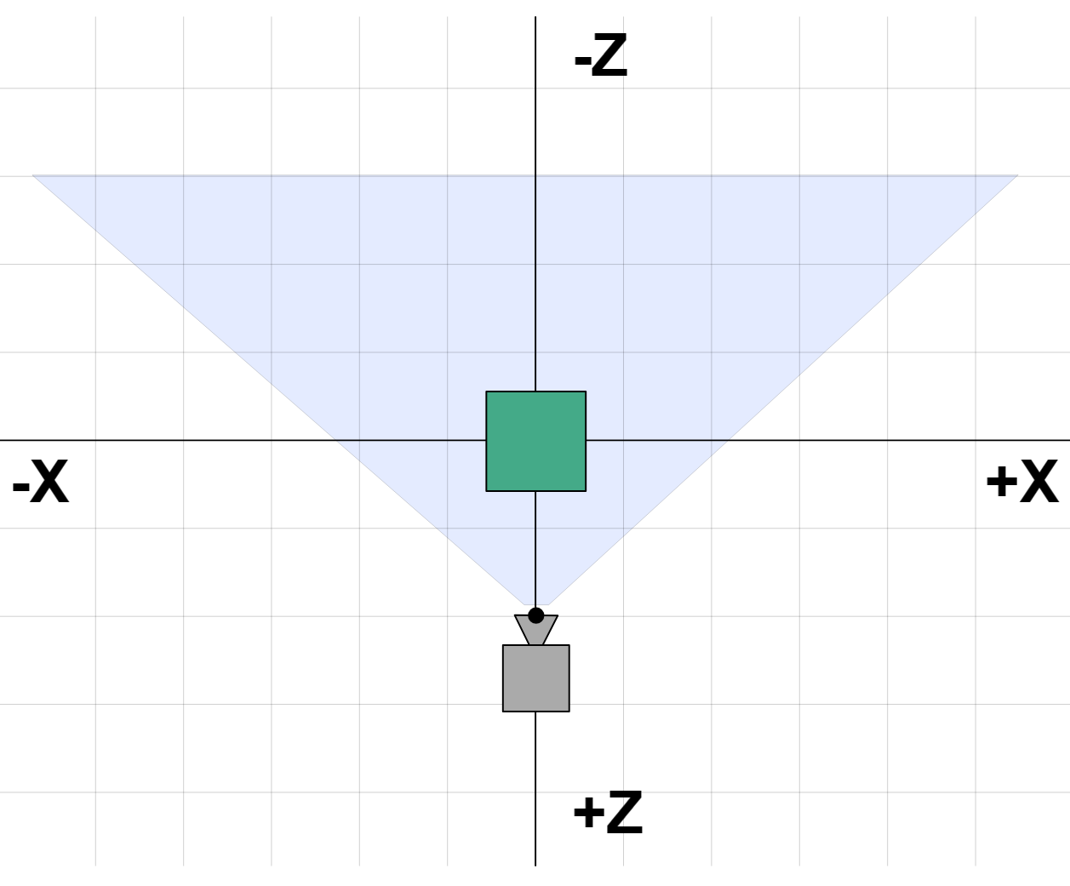
Hello cube - create a camera
camera.position.z = 2;
Those settings define a "frustum". Anything inside the defined frustum will be drawn.
camera defaults to looking down the -Z axis with +Y up.
put a cube at the origin so we need to move the camera back a little

Slide 15
Hello cube - make a Scene
const scene = new THREE.Scene();
Anything you want three.js to draw needs to be added to the scene.

Slide 16
Hello cube - create a BoxGeometry and basic material
BoxGeometry contains the data for a box which defines the vertices that make up our 3D object.
Then create a basic material and set its color(green).
const boxWidth = 1;
const boxHeight = 1;
const boxDepth = 1;
const geometry = new THREE.BoxGeometry(boxWidth, boxHeight, boxDepth);
const material = new THREE.MeshBasicMaterial({color: 0x00FF00});

Slide 17
Hello cube - create a mesh
const mesh = new THREE.Mesh(geometry, material);
Mesh
1. A Geometry (the shape of the object)
2. A Material (how to draw the object, shiny or flat, what color, what texture(s) to apply. Etc.)
3. The position, orientation, and scale of that object

Slide 18
Hello cube - add mesh to scene and render
scene.add(mesh);
renderer.render(scene, camera);
render the scene by calling the renderer's render function

Slide 19
Hello cube - animate the cube
function render(time) {
time *= 0.001; // convert time to seconds
mesh.rotation.x = time;
mesh.rotation.y = time;
renderer.render(scene, camera);
requestAnimationFrame(render);
}
requestAnimationFrame(render);
requestAnimationFrame(callback)
requestAnimationFrame() method tells the browser that you wish to perform an animation.
callback function
A function to call when it is time to update your animation. The callback has one single argument, a DOMHighResTimeStamp, which indicates the current time.

Slide 20
Hello cube - output in javascript
…
<p id="demo"></p>
…
document.getElementById("demo").innerText = (camera.position.z);
…
Use the innerText property to change the inner text of the HTML element

Slide 21
Hello cube – add a light
(0,0,0)
(-1,2,4)
const color = 0xFFFFFF;
const intensity = 3;
const light = new THREE.DirectionalLight(color, intensity);
light.position.set(-1, 2, 4);
scene.add(light);
Directional lights have a position and a target. Both default to 0, 0, 0.
Change material to a MeshPhongMaterial which is affected by lights.
− const material = new THREE.MeshBasicMaterial({color: 0x22FF33});
+ const material = new THREE.MeshPhongMaterial({color: 0x22FF33});

Slide 22
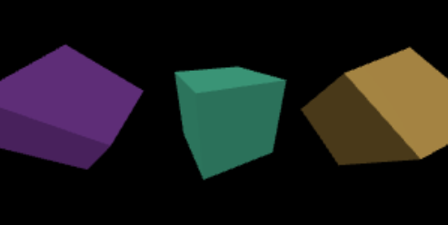
Lab
Add 2 more cubes:
different material
different position and rotating angle

Slide 23

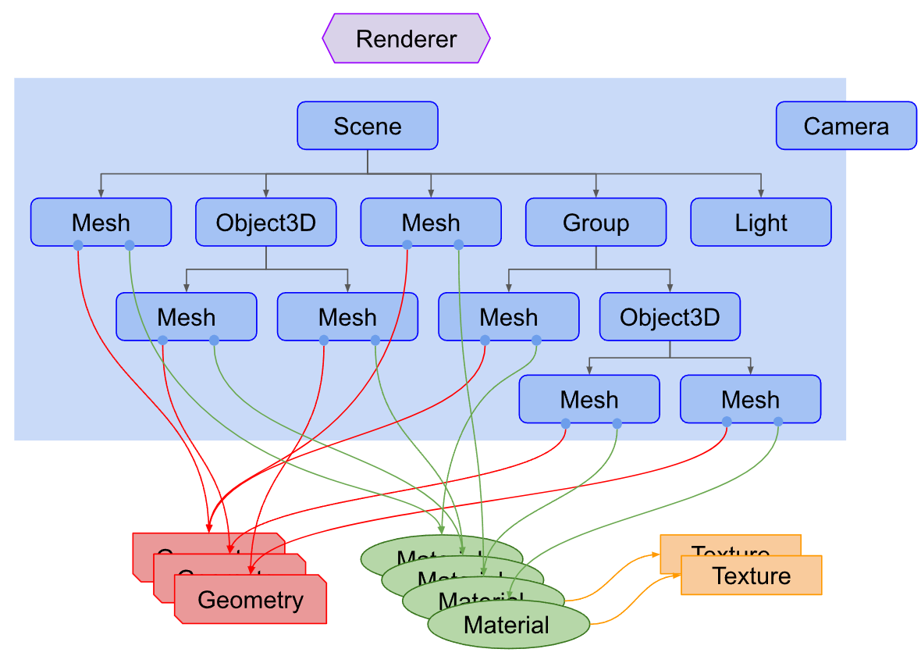
A three.js scene graph is made up of objects of type THREE.Object3D
Cameras, lights, and visible objects are all represented by subclasses of Object3D.

Slide 24
Renderer
domElement
<canvas>
Scene
Light
Camera
Mesh
Vertex
Geometry
Material
Face3
renderer.render( scene, camera );

Slide 25

An Object3D, obj, has an associated transformation
  obj.scale,
  obj.rotation,
  obj.position
  obj.matrix —-The local transform matrix.
  obj.matrixWorld global transformation matrix
  obj.modelViewMatrix
camera.position.z = 20;
obj.scale.y = 0.5;

Slide 26

scene = new THREE.Scene();
var node = new THREE.Object3D();
var group = new THREE.Group();
scene.add(group);
group.add(node);

Slide 27


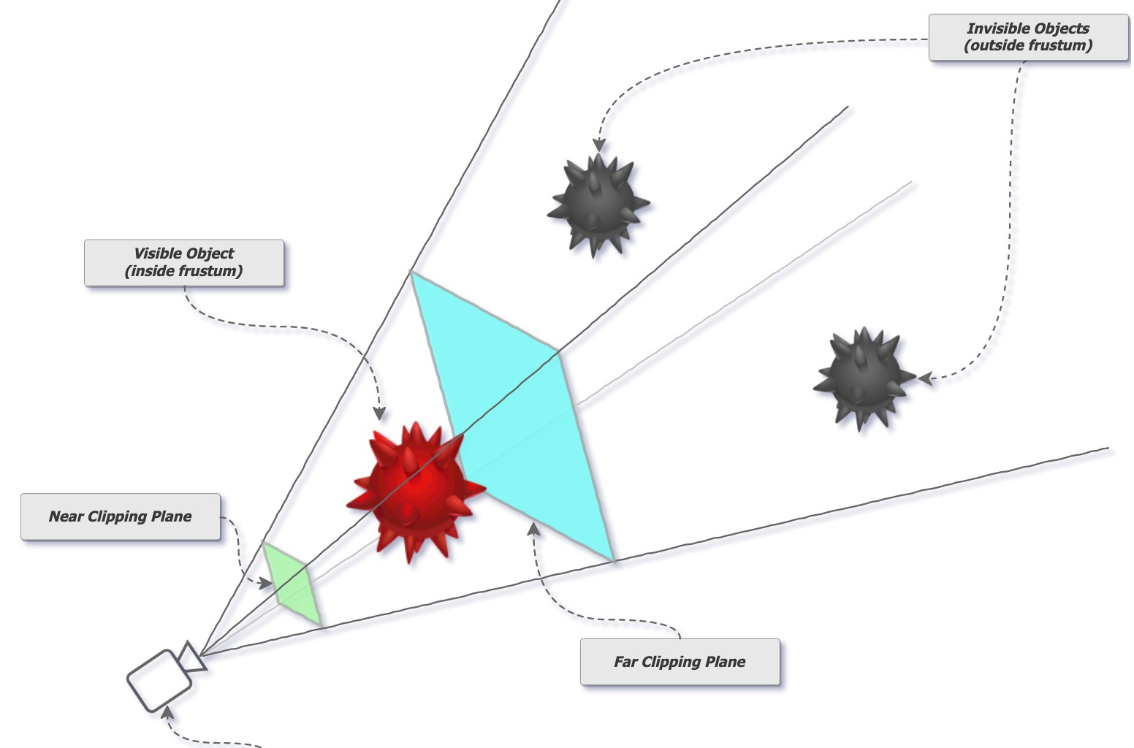
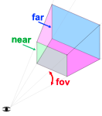
PerspectiveCamera( fov : Number, aspect : Number, near : Number, far : Number )
fov — Camera frustum vertical field of view. aspect — Camera frustum aspect ratio. near — Camera frustum near plane.
far — Camera frustum far plane.
define the camera's viewing frustum.
var camera = new THREE.PerspectiveCamera( 45, canvas.clientWidth/canvas.clientHeight,
1, 1000 );
renderer.add( camera );
https://discoverthreejs.com/book/1-first-steps/2-lights-color-action/

Slide 28

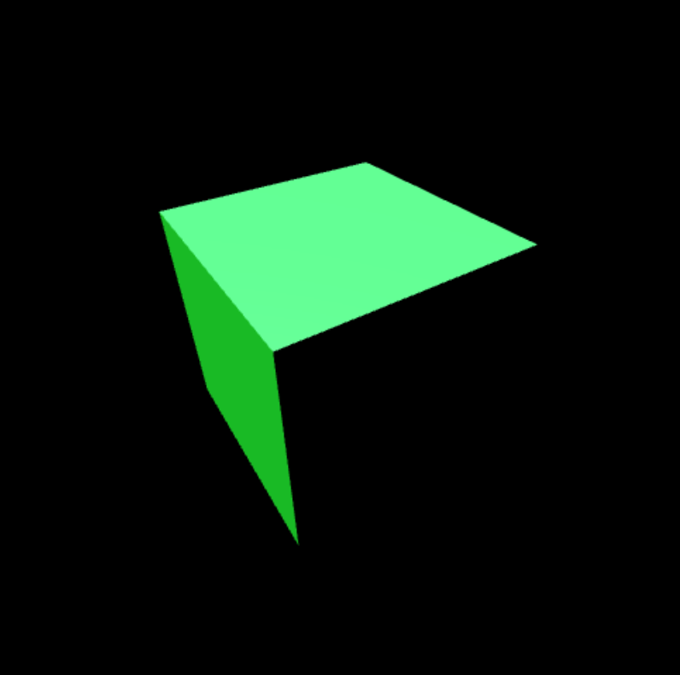
Orbit controls allow the camera to orbit around a target.
const camera = new THREE.PerspectiveCamera(fov, aspect, near, far);
const controls = new OrbitControls(camera,renderer.domElement);
camera.position.z = 2;
controls.update();
<script https://cdn.jsdelivr.net/npm/three-orbitcontrols@2.102.1/OrbitControls.js>

Slide 29
Responsive Design 響應式設計(全螢幕)
<style>
html, body {
margin: 0;
height: 100%;
}
#c {
width: 100%;
height: 100%;
display: block;
}
</style>
Webpage is displaying well on different sized displays from desktops to tablets to phones.
html and body height to 100% makes them fill the window.
Set its display mode to block. A canvas's default display mode is inline. It can add whitespace to what is displayed.

Slide 30
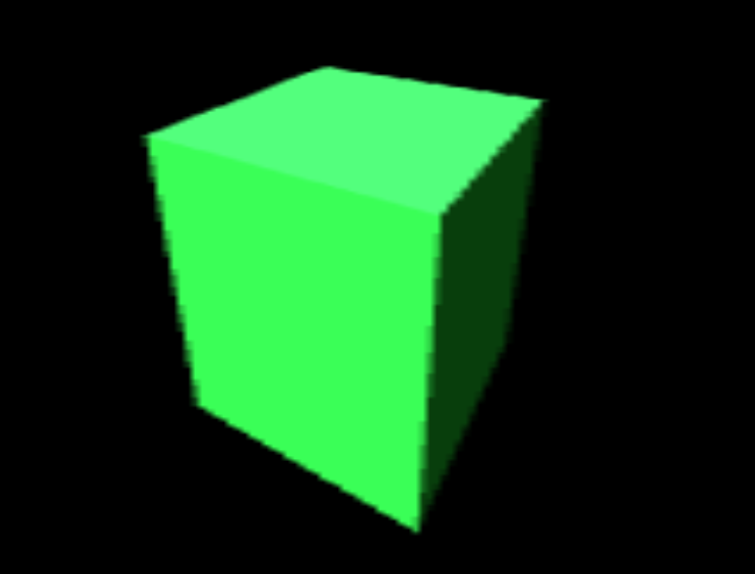
Responsive Design 響應式設計(全螢幕)
function render(time) {
time *= 0.001;
…
camera.aspect = canvas.clientWidth / canvas.clientHeight;
camera.updateProjectionMatrix();
...
Fix the stretchy problem. We need to set the aspect of the camera. We can do that by looking at the canvas's clientWidth and clientHeight properties.

Slide 31
Responsive Design 響應式設計(全螢幕)
function resizeRendererToDisplaySize(renderer) {
const needResize =
(canvas.width !== canvas.clientWidth) ||
(canvas.height !== canvas.clientHeight);
if (needResize) {
renderer.setSize(canvas.clientWidth,
canvas.clientHeight, false);
}
return needResize;
}
Canvas elements have 2 sizes. One size is the size the canvas is displayed on the page. The other size is the number of pixels in the canvas itself.
A canvas's internal size set by calling renderer.setSize.
Set false, then canvases used by three is not different than other elements.

Slide 32
Responsive Design 響應式設計(全螢幕)
function render(time) {
time *= 0.001;
…
if (resizeRendererToDisplaySize(renderer)) {
camera.aspect = canvas.clientWidth / canvas.clientHeight;
camera.updateProjectionMatrix();
}
...

Slide 33


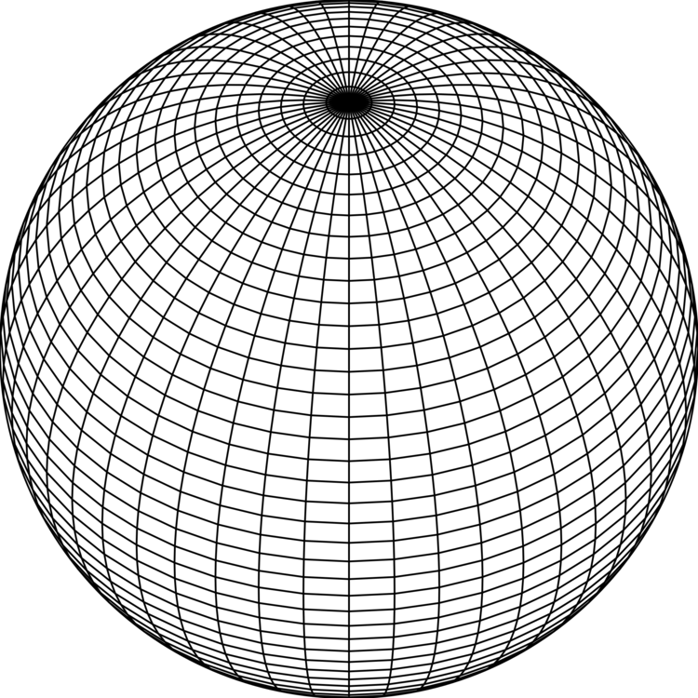
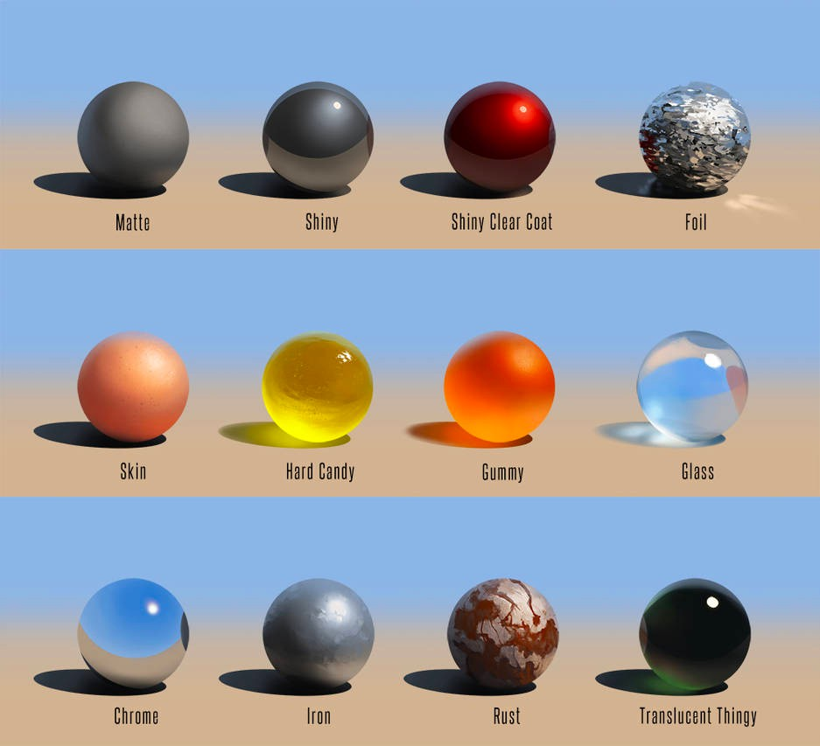
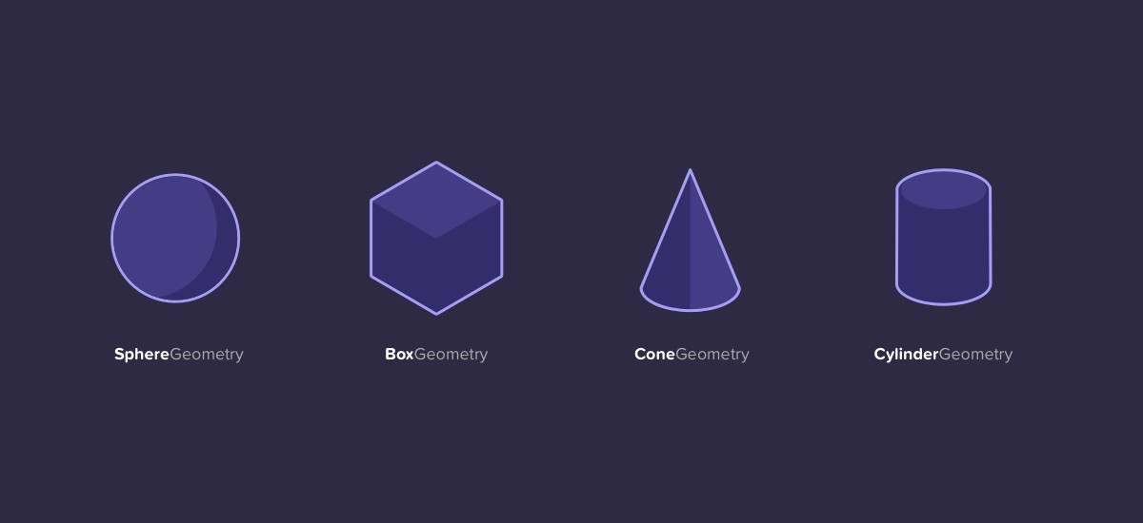
Material
Geometry
https://www.deviantart.com/phospheneart/art/Material-Spheres-481302617

Slide 34

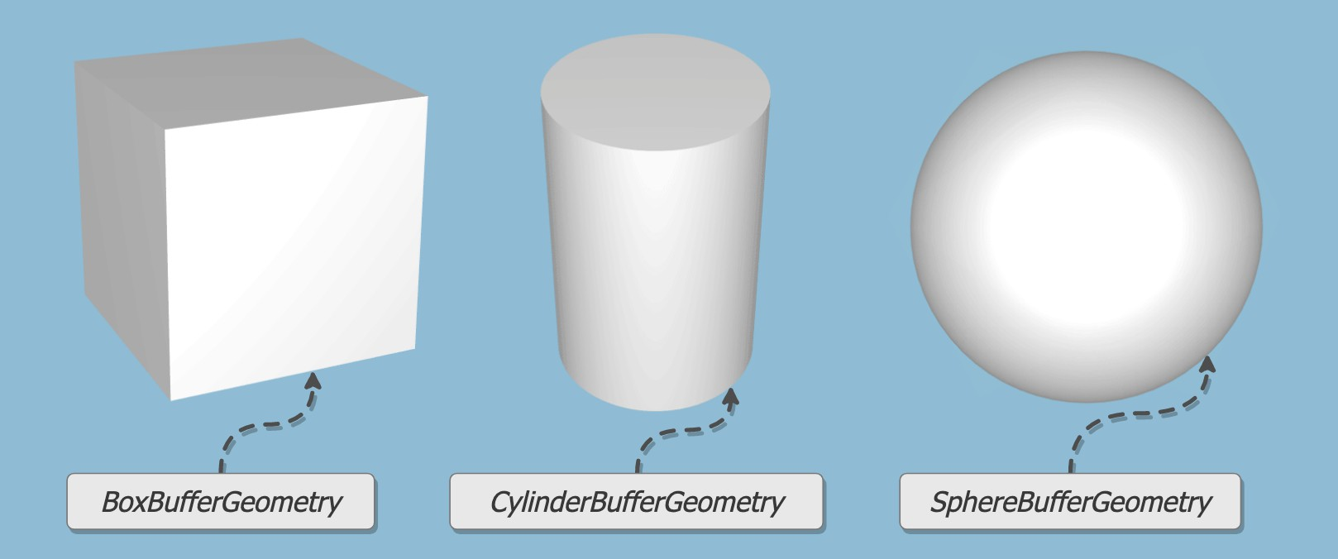
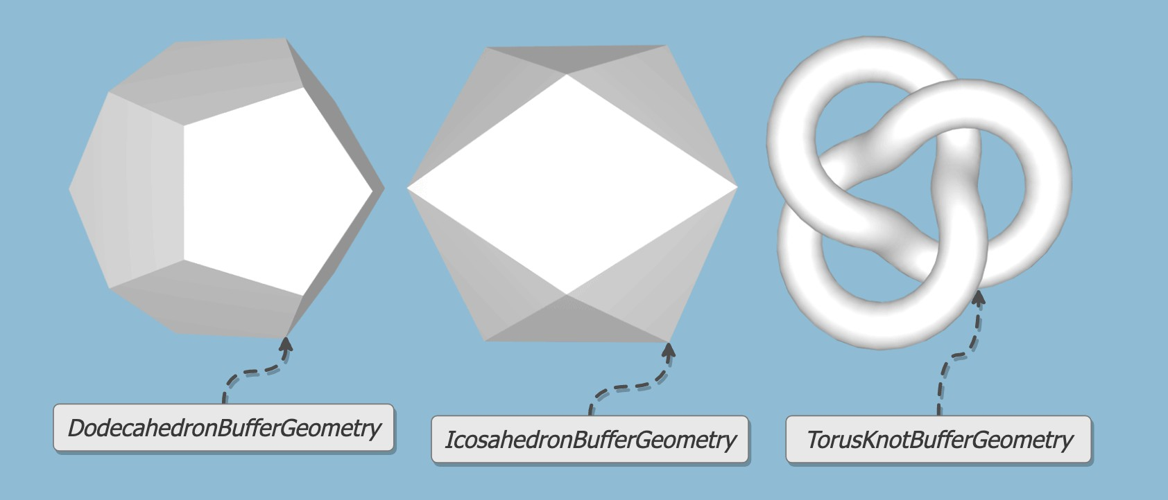
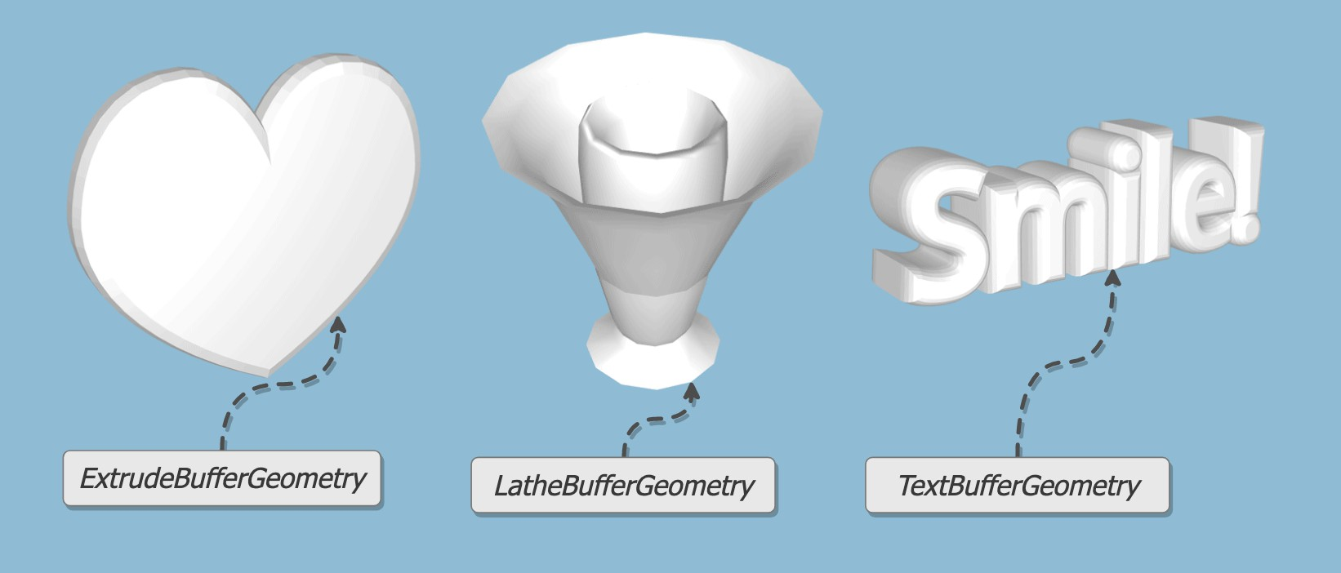
BoxGeometry ConeGeometry
SphereGeometry
CylinderGeometry TorusGeometry PlaneGeometry

Slide 35











Geometry
  sphere.geometry
    sphere.geometry.vertices
    sphere.geometry.faces
Transformaton
  sphere.position // contains x, y and z
  sphere.rotation // same
  sphere.scale // ... same

Slide 36
BoxGeometry
BoxGeometry(width : Float, height : Float, depth : Float, widthSegments : Integer, heightSegments : Integer, depthSegments : Integer)
var geometry = new THREE.BoxGeometry( 1, 1, 1 );
var material = new THREE.MeshBasicMaterial( {color: 0x00ff00} ); var cube = new THREE.Mesh( geometry, material );
scene.add( cube );

Slide 37
SphereGeometry
SphereGeometry(radius : Float, widthSegments : Integer, heightSegments : Integer, phiStart : Float, phiLength : Float, thetaStart : Float, thetaLength : Float)
var sgeometry = new THREE.SphereGeometry( 1, 32, 32 );
var smaterial = new THREE.MeshBasicMaterial( {color: 0xffff00} );
var spmesh = new THREE.Mesh( sgeometry, smaterial );
scene.add( spmesh );

Slide 38
Other Geometry
const geometry = new THREE.ConeGeometry(
radius, height, radialSegments );
const geometry = new THREE.CylinderGeometry(
radiusTop, radiusBottom, height, radialSegments );
const geometry = new THREE.IcosahedronGeometry( radius );
const geometry = new THREE.TorusGeometry(
radius, tubeRadius, radialSegments, tubularSegments );
const geometry = new THREE.TorusKnotGeometry(
radius, tubeRadius, tubularSegments, radialSegments, p, q );

Slide 39
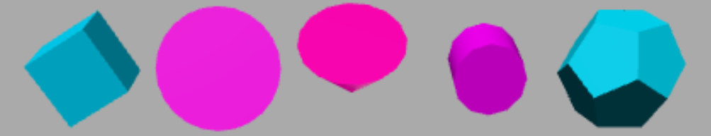
Lab
Try to draw the following meshes with self rotation animation

Slide 40
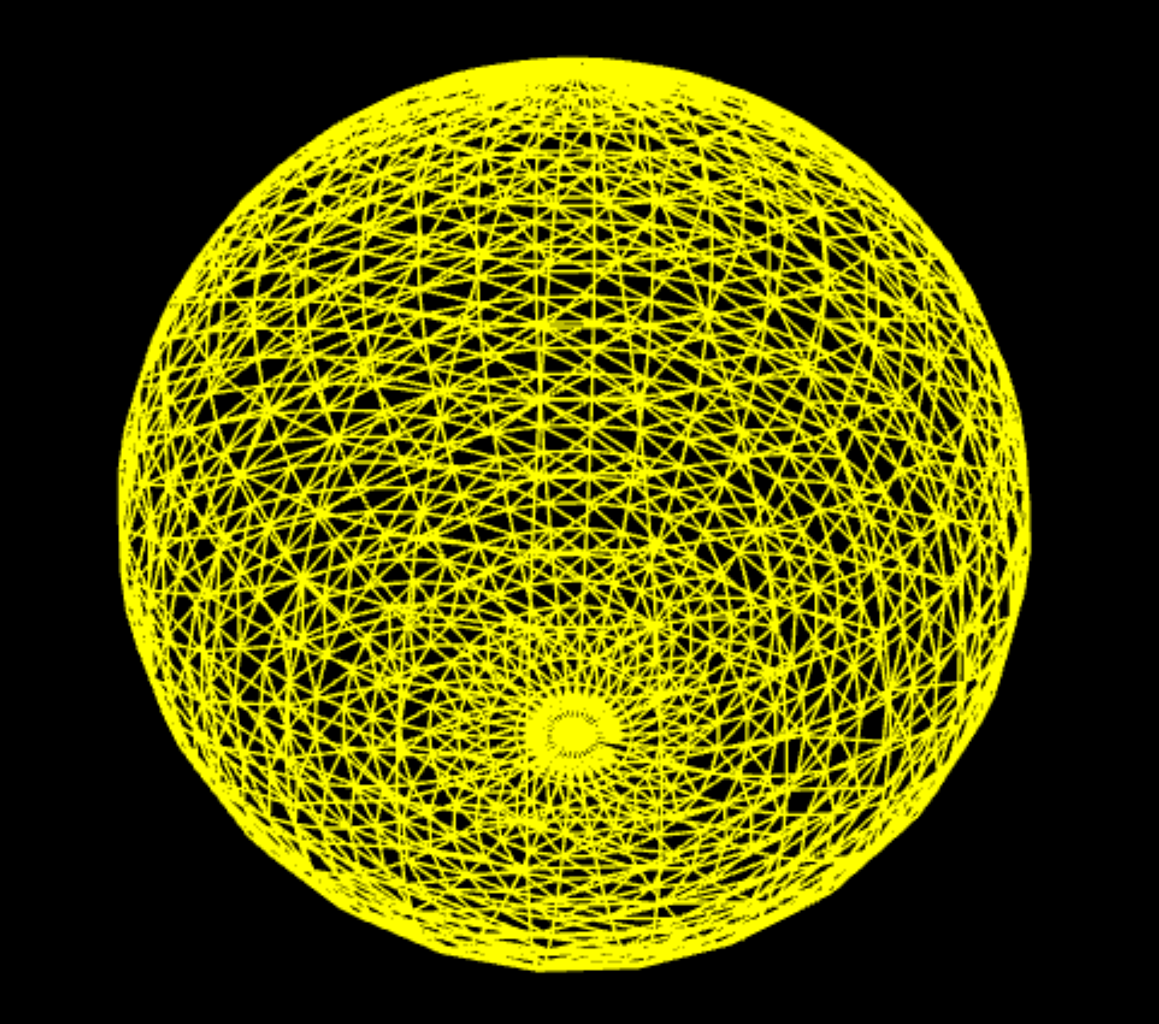
WireframeGeometry
const geometry = new THREE.SphereGeometry( 100, 100, 100 );
const material = new THREE.MeshBasicMaterial({ color: 0xffff00, wireframe: true});
const mesh = new THREE.Mesh( geometry, material );

Slide 41

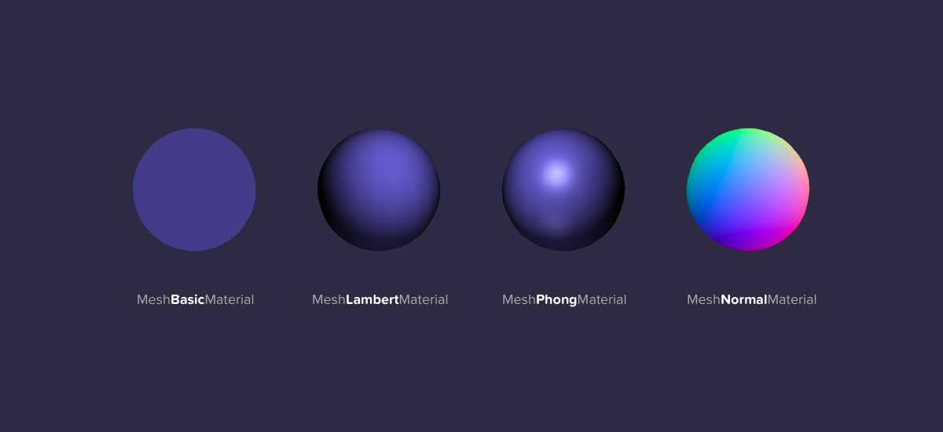
MeshBasicMaterial
MeshLambertMaterial
MeshNormalMaterial
MeshPhongMaterial
•
RawShaderMaterial
ShaderMaterial
ShadowMaterial
SpriteMaterial

Slide 42

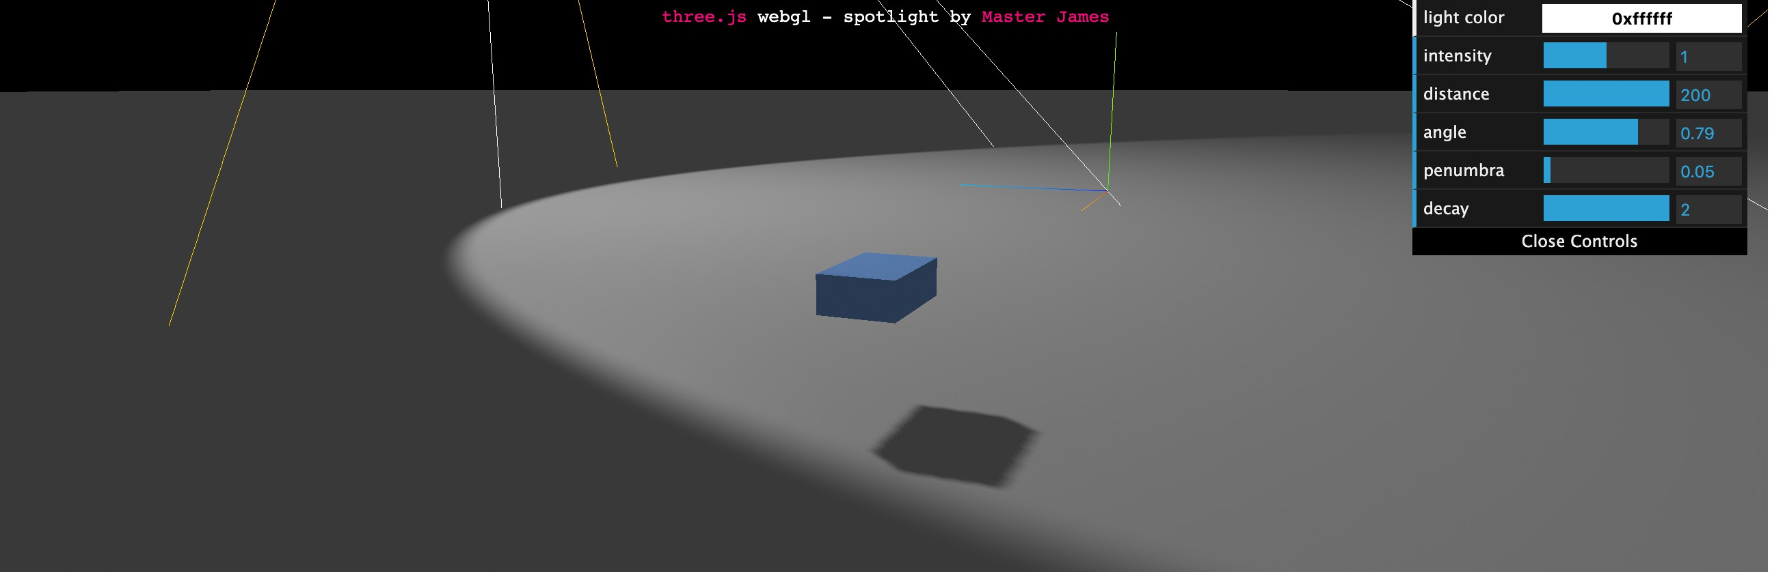
AmbientLight
DirectionalLight
HemisphereLight
PointLight
RectAreaLight
SpotLight

Slide 43
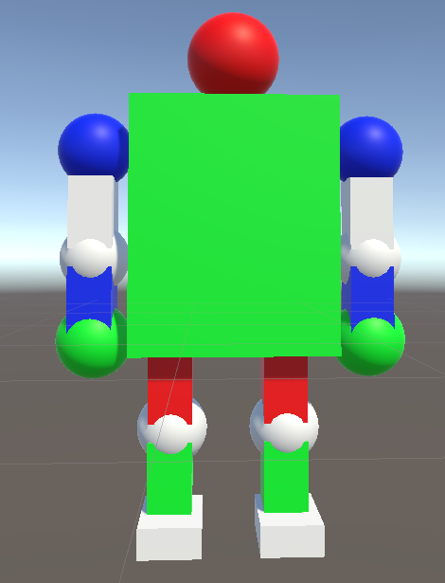
Homework_2
1.請使用geometry相關指令(如BoxGeometry, ConeGeometry, SphereGeometry, CylinderGeometry, TorusGeometry等)，組合為一個簡單的三維機器人模型
2.請不要讀入外部模型檔案(如obj檔)來繪製機器人模型，而是使用項目1的指令來表現
3.建立一個點光源(PointLight)圍繞著機器人旋轉的動畫
Optional：請利用移動、旋轉、縮放指令，創作機器人動畫
* 11/13 demo Homework_1與Homework_2
* 11/13 demo 前請將Homework_1與Homework_2相關檔案壓縮後上傳雲端學院

Slide 44
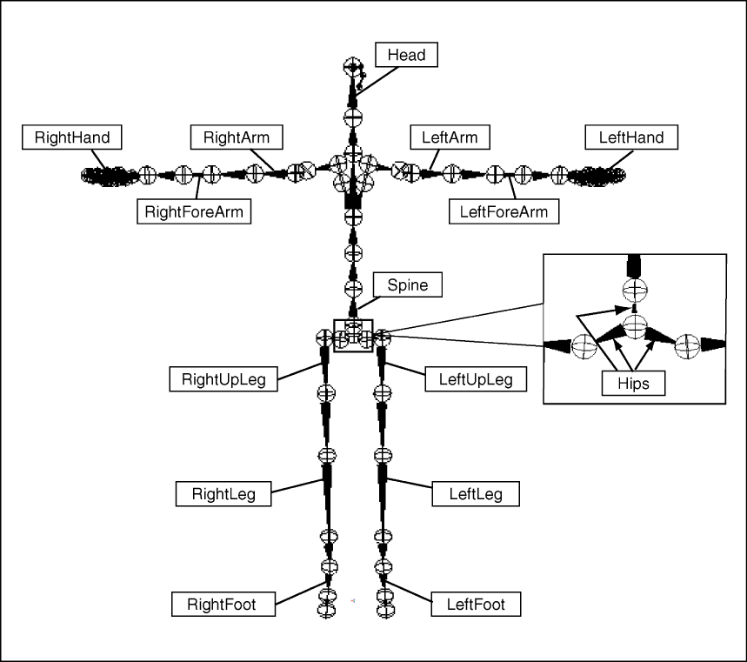
Renderer
Scene
Light
Camera
Mesh
Vertex
Geometry
Material
Face3

Slide 45
RightShoulder
Head
LeftShoulder
RightArm
Body
LeftArm
RightJointArm
LeftJointArm
腳節點設計類似手，主要是讓大腿與小腿有適當旋轉的節點
RightForeArm
LeftForeArm
RightHand
LeftHand

